Slide 1
SNAKE
INVADERS
by CODFathers

Slide 2
About The Game
Snake Invaders
You are a character in an endless void.
After 60 Seconds, a Army of Space Shooters will attack you, you need to kill them and survive for as long as you can.
You can travel and collect different powerups:
Increase Health
Increase Strength
Increase Speed

Slide 3
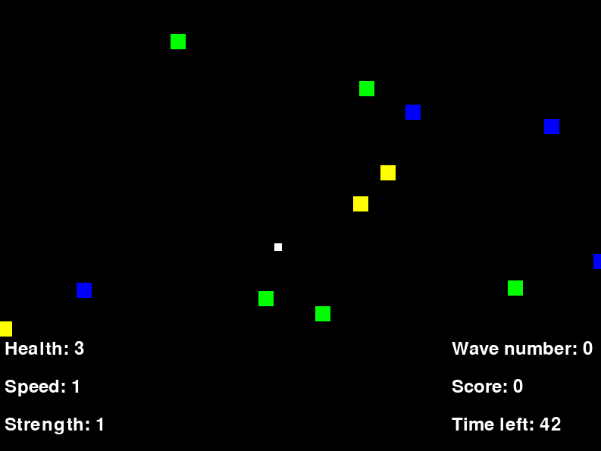
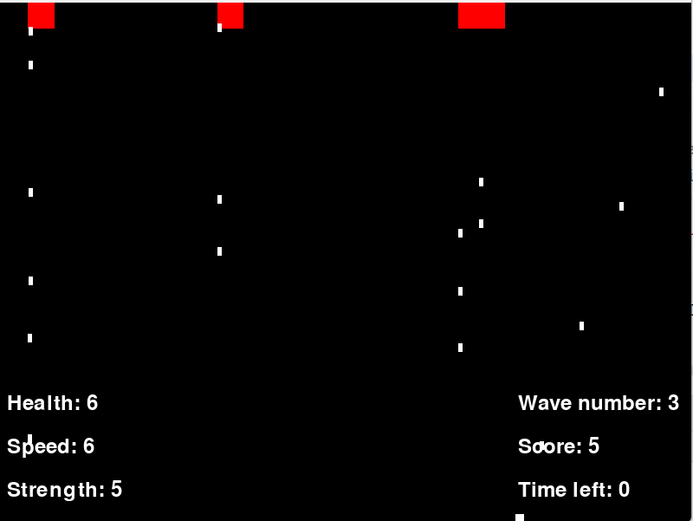
GAMEPLAY

Slide 4









Thank You

